Slide 1
pharmacology - pharmacokinetics

Slide 2
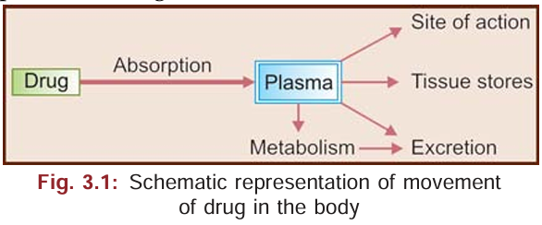
Pharmacokinetics
Pharmacokinetics is the study of the absorption, distribution, metabolism and excretion of drugs, i.e. the movement of the drugs into, within and out of the body.
For a drug to produce its specific response, it should be present in adequate concentrations at the site of action.

Slide 3
Mechanisms of Transport of Drugs Across Biological Membranes
Passive transfer
• Simple diffusion
• Filtration
Carrier-mediated transport
• Active transport
• Facilitated diffusion
Endocytosis

Slide 4
Passive Transfer
The drug moves across a membrane without any need for energy.
Simple diffusion is the transfer of a drug across the membrane in the direction of its concentration gradient. Lipid soluble drugs are transferred across membranes by simple diffusion—after dissolving in the lipids of the cell membrane.
Filtration is the passage of drugs through aqueous pores in the membrane. Water soluble drugs with molecular size smaller than the diameter of the pores cross the biological membranes by filtration.

Slide 5
Carrier-mediated Transport
Active transport is the transfer of drugs against a concentration gradient and needs energy. It is carried by a specific carrier protein. Only drugs related to natural metabolites are transported by this process, e.g. levodopa, iron, amino acids. The compound binds to a specific carrier on one side of the membrane and moves across the cell. At the other side of the cell, the complex dissociates and the carrier moves back to transport another molecule. Other substances competing for the same mechanism for transport may interfere with drug movement as this process is saturable, e.g. penicillin and probenecid - duration of action of penicillin is prolonged because both of them compete for renal tubular secretion.
Facilitated diffusion is a unique form of carrier transport which differs from active transport in that it is not energy dependent and the movement occurs in the direction of the concentration gradient. The carrier facilitates diffusion and is highly specific for the substance, e.g. uptake of glucose by cells, vitamin B12 from intestines.

Slide 6
Endocytosis
Endocytosis is the process where small droplets are engulfed by the cell. Some proteins are taken up by this process (like pinocytosis in amoeba). This process is currently being tried for delivery of some anticancer drugs to the tissues. The reverse process— exocytosis is responsible for secretion of many substances from cells, e.g. neurotransmitters stored in nerve endings.

Slide 7
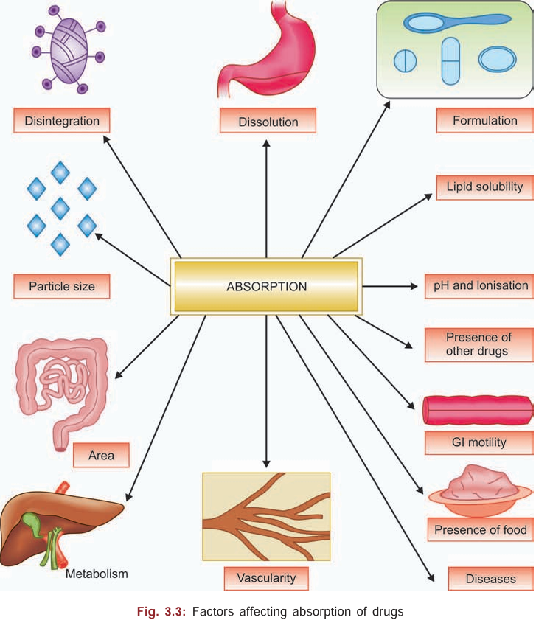
ABSORPTION
Absorption is defined as the passage of the drug from the site of administration into the circulation. For a drug to reach its site of action, it must pass through various membranes depending on the route of administration. Absorption occurs by one of the processes described above, i.e. passive diffusion or carrier-mediated transport. Thus except for intravenous route, absorption is important for all other routes of administration. Several factors influence the rate and extent of absorption of a drug

Slide 8
Disintegration and dissolution time
The drug taken orally should break up into individual particles (disintegrate) to be absorbed. It then has to dissolve in the gastrointestinal fluids. In case of drugs given subcutaneously or intramuscularly, the drug molecules have to dissolve in the tissue fluids. Liquids are absorbed faster than solids. Delay in disintegration and dissolution as with poorly water-soluble drugs like aspirin, results in delayed absorption.

Slide 9
Formulation
Pharmaceutical preparations are formulated to produce desired absorption. Inert substances used with drugs as diluents like starch and lactose may sometimes interfere with absorption.
Small particle size is important for better absorption of drugs. Drugs like corticosteroids, griseofulvin, digoxin, aspirin and tolbutamide are better absorbed when given as small particles. On the other hand, when a drug has to act on the gut and its absorption is not desired, then particle size should be kept large, e.g. anthelmintics like bephenium hydroxynaphthoate.
Lipid soluble drugs are absorbed faster and better by dissolving in the phospholipids of the cell membrane.
Particle size
Lipid solubility

Slide 10
pH and ionisation
Ionised drugs are poorly absorbed while unionised drugs are lipid soluble and are well absorbed. Most drugs are weak electrolytes and exist in both ionized and unionized forms. But the degree of ionisation depends on the pH. Thus acidic drugs remain unionised in the acidic medium of the stomach and are rapidly absorbed from the stomach, e.g. aspirin, barbiturates. Basic drugs are unionised when they reach the alkaline medium of the intestine from where they are rapidly absorbed, e.g. pethidine, ephedrine. Strong acids and bases are highly ionised and therefore poorly absorbed, e.g. heparin, streptomycin.

Slide 11
Area and vascularity of the absorbing surface
The larger the area of absorbing surface and more the vascularity—better is the absorption. Thus most drugs are absorbed from the small intestine.
Gastric emptying time—if gastric emptying is faster, the passage of the drug to the intestines is quicker and hence absorption is faster.
Intestinal motility—when highly increased as in diarrhoeas, drug absorption is reduced.
Gastrointestinal motility

Slide 12
Presence of food
delays gastric emptying, dilutes the drug and delays absorption. Drugs may form complexes with food constituents and such complexes are poorly absorbed, e.g. tetracyclines chelate calcium present in the food because of which their bioavailability is decreased. Moreover, certain drugs like ampicillin, roxithromycin and rifampicin are well absorbed only on empty stomach.

Slide 13
Metabolism
Some drugs may be degraded in the GI tract, e.g. nitroglycerine, insulin. Such drugs should be given in higher doses or by alternative routes.
like malabsorption and achlorhydria result in reduced absorption of drugs.
Diseases of the gut

Slide 14
FIRST PASS METABOLISM

